Slide 1
UNIT FOUR
ORGANIZATIOAL STRUCTURE

Slide 2
WHAT IS AN ORGANIZATIONAL STRUCTURE?
The typically hierarchical arrangement of
lines of authority, communications, rights
and duties of an organization.
Organizational structure determines how
the roles, power and responsibilities are
assigned, controlled, and coordinated, and
how information flows between the
different levels of management and eventually
down to the front line workers.

Slide 3
TYPES OF ORGANIZATIONAL STRUCTURES
Functional structure is set up so
that each portion of the
organization is grouped
according to its purpose.

Slide 4
Divisional structure typically is used
in larger companies that operate in a
wide geographic area or that have
separate smaller organizations
within the umbrella group to cover
different types of products or market
areas.

Slide 5
The third main type of organizational
structure, called the matrix structure,
is a hybrid of divisional and functional
structure. Typically used in large
multinational companies, the matrix
structure allows for the benefits of
functional and divisional structures to
exist in one organization.

Slide 6
MECHANISTIC AND ORGANIC
Mechanistic | Organic
Individual specialization: Employees work separately and specialize in one task | Joint Specialization: Employees work together and coordinate tasks
Simple integrating mechanisms: Hierarchy of authority well-defined | Complex integrating mechanisms: task forces and teams are primary integrating mechanisms
Centralization: Decision-making kept as high as possible. Most communication is vertical. | Decentralization: Authority to control tasks is delegated. Most communication lateral

Slide 7
Standardization: Extensive use made of rules & Standard Operating Procedures | Mutual Adjustment: Face-to-face contact for coordination. Work process tends to be unpredictable
Much written communication | Much verbal communication
Informal status in org based on size of empire | Informal status based on perceived brilliance
Organization is a network of positions, corresponding to tasks. Typically each person corresponds to one task | Organization is network of persons or teams. People work in different capacities simultaneously and over time

Slide 8
FORMAL AND INFORMAL ORGANIZATION STRUCTURES
Managers have to deal with two
organizations.
They must deal with-one:
formal
informal

Slide 9
The Formal Organization is
usually delineated by an
organizational chart and job
descriptions. The official
reporting relationships are
clearly known to every manager.

Slide 10
Informal Organization an informal organization is the set of evolving relationships and patterns of human interaction within an organization which are not officially presented. Alongside the formal organization, an informal organization structure exists which consists of informal relationships created not by officially designated managers but by organizational members at every level.

Slide 11
CHARACTERISTICS INFORMAL ORGANIZATION
Its members are joined together to satisfy their personal needs (needs for affiliation, friendship etc.)
It is continuously changing:
The informal organization is dynamic.
It involves members from various organizational levels.
It is affected by relationship outside the firm.
It has a pecking order: certain people are assigned greater importance than others by the informal group.

Slide 12
BENEFITS OF INFORMAL ORGANIZATION:
assists in accomplishing the work faster.
helps to remove weakness in the formal structure.
lengthens the effective span of control.
compensation for violations of formal organizational principles.
provides an additional channel of communication.
provides emotional support for employees.
encourages better management.

Slide 13
DISADVANTAGES OF INFORMAL
ORGANIZATION:
may work against the purpose of formal organization.
reduces the degree of predictability and control.
reduces the number of practical alternatives.
increases the time required to complete activities.

Slide 14
Formal organizational structures are categorized as:
Line organizational structure.
Staff or functional authority organizational structure.
Line and staff organizational structure.
Committee organizational structure.

Slide 15
Divisional organizational structure.
Project organizational structure.
Matrix organizational structure and Hybrid organizational structure.

Slide 16
LINE ORGANIZATIONAL STRUCTURE
A line organization has only direct, vertical relationships between different levels in the firm. There are only line departments-departments directly involved in accomplishing the primary goal of the organzation.

Slide 17
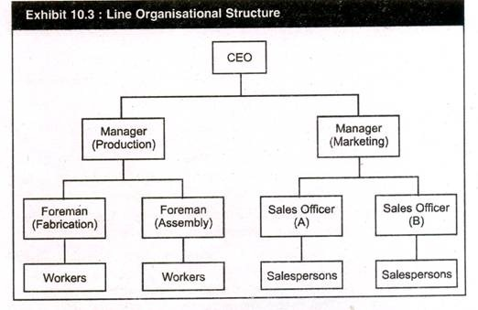

Slide 18
ADVANTAGES:
Tends to simplify and clarify authority, responsibility and accountability relationships
Promotes fast decision making
Simple to understand.

Slide 19
DISADVANTAGES:
1. Neglects specialists in planning
2. Overloads key persons.
Some of the advantages of a pure line organization are:
a line structure tends to simplify and clarify responsibility, authority and accountability relationships. The levels of responsibility and authority are likely to be precise and understandable.
a line structure promotes fast decision making and flexibility.
Because line organizations are usually small, managements and employees have greater closeness.

Slide 20
Because line organizations are usually small, managements and employees have greater closeness.
However, there are some disadvantages also. They are:
as the firm grows larger, line organization becomes more ineffective.
improved speed and flexibility may not offset the lack of specialized knowledge.
managers may have to become experts in too many fields.
there is a tendency to become overly dependent on the few key people who an perform numerous jobs.

Slide 21
STAFF OR FUNCTIONAL AUTHORITY ORGANIZATIONAL STRUCTURE
The jobs or positions in an organisation can be categorized as:
(i) Line position:
a position in the direct chain of command that is responsible for the achievement of an organisation’s goals and
(ii) Staff position:
A position intended to provide expertise, advice and support for the line positions.

Slide 22
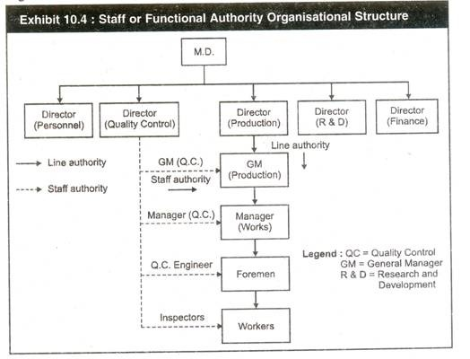

Slide 23
LINE AND STAFF ORGANISATIONAL STRUCTURE:
Most large organizations belong to
this type of organizational structure.
These organizations have direct,
vertical relationships between
different levels and also specialists
responsible for advising and
assisting line managers.

Slide 24
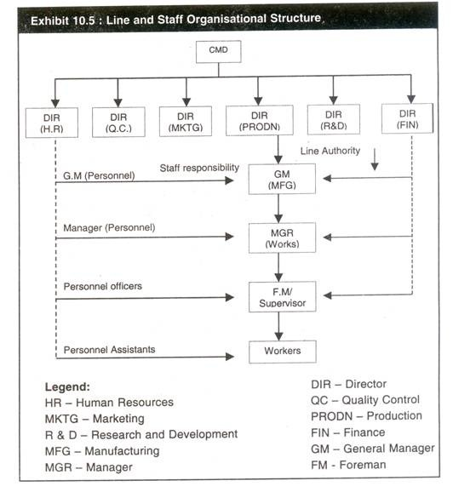

Slide 25
Three types of specialized staffs can be identified:
advising,
service and
control

Slide 26
SOME DISADVANTAGES ARE:
Even through a line and staff structure allows higher flexibility and specialization it may create conflict between line and staff personnel.
Line managers may not like staff personnel telling them what to do and how to do it even though they recognize the specialists’ knowledge and expertise.
Some staff people have difficulty adjusting to the role, especially when line managers are reluctant to accept advice.
Staff people may resent their lack of authority and this may cause line and staff conflict.

Slide 27
MATRIX ORGANIZATIONAL STRUCTURE:
It is a permanent organization designed
to achieve specific results by using teams
of specialists from different functional
areas in the organization.

Slide 28
ADVANTAGES:
decentralized decision making.
strong product/project co-ordination.
improved environmental monitoring.
fast response to change.
flexible use of resources.
efficient use of support systems.

Slide 29
DISADVANTAGES:
High administration cost.
Potential confusion over authority and responsibility.
High prospects of conflict.
Overemphasis on group decision making.
Excessive focus on internal relations.

Slide 31
FEATURES OF THE FORMAL ORGANIZATION
Tall and Flat
Hierarchy of Authority
Chain of command
Span of control
Division of labour
Delegation
Responsibility
Centralisation and Decentralisation

Slide 32
TALL AND FLAT
Tall organizational structure is one which has many levels of hierarchy. In these organizations, there are usually many managers, and each manager has a small span of control – they are in charge of only a small group of people. Tall structures tend to be more complicated and complex, and may be slower to respond to market changes than organizations where managers have a larger span of control.

Slide 33
In tall organizations, there are many layers of middle management between top management and employees. Each layer of management often develops its own rules and procedures.
Because managers in a tall organization only have a small number of employees to supervise, they are able to supervise more closely and spend more time on training employees.
However, employee satisfaction may be lower in a tall organization because of the many layers of bureaucracy and rigid rules, and because employees have fewer opportunities to take on responsibility.

Slide 34
The many layers of management mean that there are clear lines of communication in a tall organization, but it can be very difficult for decisions to be made. Decision making is often slowed down because approval may be needed by many different people, and it can be difficult for managers to access executives without going through a long line of management.
Tall organizations may face higher costs than in other types of business structures. One reason for this is the large number of managers and supervisors required in a tall structure. Costs may also increase due to the increased time taken in making decisions and the delays this may cause.

Slide 35
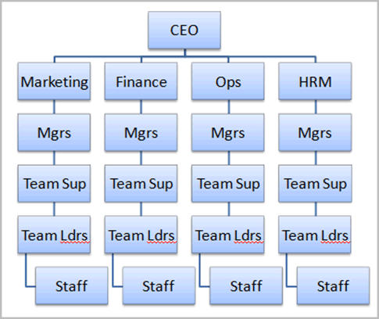
TALL ORGANIZATIONAL CHART

Slide 36
Flat organizational structures have fewer management levels, with each level controlling a broad area or group. Flat organizations focus on empowering employees rather than adhering to the chain of command. By encouraging autonomy and self-direction, flat structures attempt to tap into employees’ creative talents and to solve problems by collaboration.

Slide 37
FLAT STRUCTURE PROS AND CONS
Flat organizations offer more opportunities for employees to excel while promoting the larger business vision. That is, there are more people at the “top” of each level. For flat structures to work, leaders must share research and information instead of hoarding it. If they can manage to be open, tolerant and even vulnerable, leaders excel in this environment. Flatter structures are flexible and better able to adapt to changes. Faster communication makes for quicker decisions, but managers may end up with a heavier workload. Instead of the military style of tall structures, flat organizations lean toward a more democratic style.

